Slide 1

KARTHIK NAIR
December 3rd, 2024
FILIP TOMOVSKI
DS5110
CUSTOMER
BEHAVIOR DASHBOARD

Slide 2
PROJECT OVERVIEW
Objective: Develop a dashboard to support data-driven decision-making.
Customer behavior
Sales trends
Demographics
Scope:
Data collection and processing (sales, customer demographics, holiday trends)
Pipeline & database design (robust ETL pipeline, scalable database scheme)
Dashboard development (intuitive and interactive dashboard with user friendly design)
Trend visualizations (seasonal patterns, customer preferences, geographical distribution)
Key Features:
Sales analysis (find high-performing products and regions)
Holiday insights (highlight holiday sales spikes)
Geographical mapping (pinpoint customer density and geographical trends)
Performance metrics (total revenue, averages)

Slide 3
MOTIVATION AND IMPORTANCE
Why?
Businesses rely on data-driven decisions
Currently solutions lack interactivity
Incorporating external factors enhances sales trends
How?
Develop smarter marketing strategies
Enhance inventory management
Understand your customer base
Pinpoint peak sales periods
Added Value:
Improved operational efficiency
Data readable by all
Scalability

Slide 4
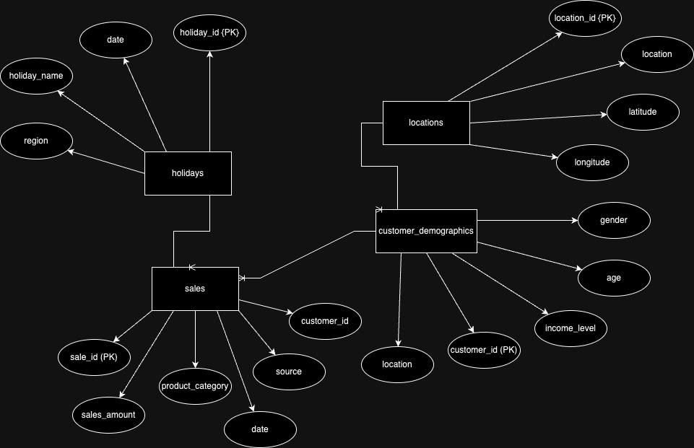
DATA SOURCES
Sales
Combined data for instore purchases from Walmart datasets and online purchases from Amazon data on Kaggle.
Locations
Studied how Walmart organizes stores across 2,614 cities and created a dataset for 2,000 cities based on proximity and population.
Holidays
Designed a dataset combining national holidays, regional holidays, and major retail events like Black Friday (2018–2023).
Customer Demographics
Synthesized data for 50,000 customers, including gender-neutral options, mapped to the 2,000 cities dataset.

Slide 5
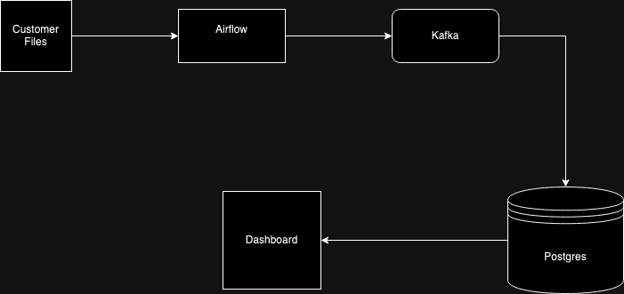
SYSTEM ARCHITECTURE

Slide 6
BACKEND DEMO

Slide 7
DASHBOARD DEMO

Slide 8
CONCLUSION
Outcomes:
Developed a scalable pipeline
Interactive dashboard with filter capabilities
Visualizations to support business decisions
Geospatial mapping
Limitations/Future work:
Scale to cloud-based storage
Enable real-time API
Multi-channel sales data (online or in-store)

Slide 9

THANK YOU

